Slide 1

Chapter 2:
The Project Management and Information Technology Context
Information Technology Project Management,
Fourth Edition

Slide 2
Learning Objectives
Describe the systems view of project management and how it applies to information technology projects.
Understand organizations, including the four frames, organizational structures, and organizational culture.
Explain why stakeholder management and top management commitment are critical for a project’s success.

Slide 3
Learning Objectives
Understand the concept of a project phase and the project life cycle and distinguish between project development and product development.
Discuss the unique attributes and diverse nature of information technology projects.

Slide 4
Projects Cannot Be Run in Isolation
Projects must operate in a broad organizational environment.
Project managers need to use systems thinking:
  Taking a holistic view of a project and understanding how it relates to the larger organization.
Senior managers must make sure projects continue to support current business needs.

Slide 5
A Systems View of Project Management
The term systems approach emerged in the 1950s to describe a holistic and analytical approach to solving complex problems.
Three parts include:
  Systems philosophy: View things as systems, which are interacting components that work within an environment to fulfill some purpose.
  Systems analysis: Problem-solving approach.
  Systems management: Address business, technological, and organizational issues before making changes to systems.

Slide 6
Media Snapshot
The Press Association Ltd., the largest news agency in the United Kingdom, hired a consulting firm to help turn things around after management noticed that its profit margins were sliding.
The consultants suggested using a holistic view and a top-down strategy to make sure projects supported key business goals.
They also suggested releasing short-term results to accrue benefits on an incremental basis and reviewing projects on a regular basis to ensure strategic alignment.*
        *Jackson, Lynne, “Forge Ahead,” PM Network (April 2004), p.48.

Slide 7
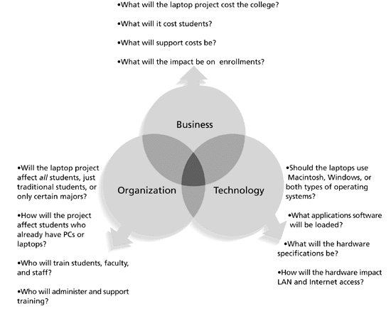
Figure 2-1. Three Sphere Model for Systems Management

Slide 8
Understanding Organizations
Structural frame: Focuses on roles and responsibilities, coordination, and control. Organization charts help define this frame.
Human resources frame: Focuses on providing harmony between needs of the organization and needs of people.
Political frame: Assumes organizations are coalitions composed of varied individuals and interest groups. Conflict and power are key issues.
Symbolic frame: Focuses on symbols and meanings related to events. Culture is important.

Slide 9
What Went Wrong?
Many enterprise resource planning (ERP) projects fail due to organizational issues, not technical issues. For example, Sobey’s Canadian grocery store chain abandoned its two-year, $90 million ERP system due to organizational problems.
As Dalhousie University Associate Professor Sunny Marche states, “The problem of building an integrated system that can accommodate different people is a very serious challenge. You can’t divorce technology from the sociocultural issues. They have an equal role.” Sobey’s ERP system shut down for five days and employees were scrambling to stock potentially empty shelves in several stores for weeks. The system failure cost Sobey’s more than $90 million and caused shareholders to take an 82-cent after-tax hit per share.*
*Hoare, Eva. “Software Hardships,” The Herald, Halifax, Nova Scotia (2001).

Slide 10
Many Organizations Focus on the Structural Frame
Most people understand what organizational charts are.
Many new managers try to change organizational structure when other changes are needed.
Three basic organizational structures:
  Functional: Functional managers report to the CEO.
  Project: Program managers report to the CEO.
  Matrix: Middle ground between functional and project structures; personnel often report to two or more bosses; structure can be a weak, balanced, or strong matrix.

Slide 11
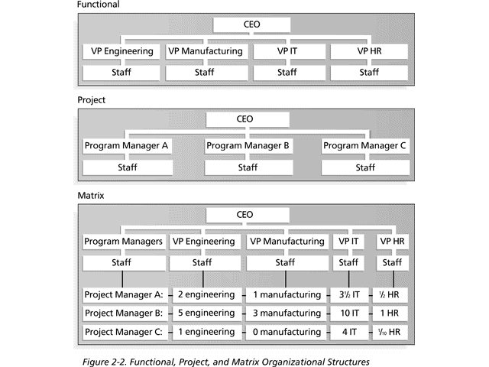
Figure 2-2. Functional, Project, and Matrix Organizational Structures

Slide 12
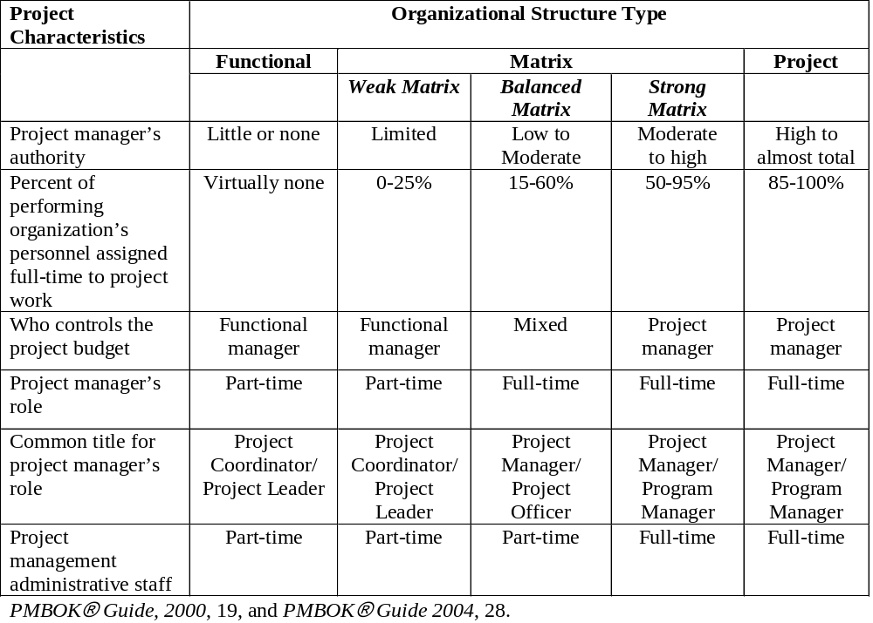
Table 2-1. Organizational Structure
Influences on Projects

Slide 13
Organizational Culture
Organizational culture is a set of shared assumptions, values, and behaviors that characterize the functioning of an organization.
Many experts believe the underlying causes of many companies’ problems are not the structure or staff, but the culture.

Slide 14
Ten Characteristics of
Organizational Culture
Member identity*
Group emphasis*
People focus
Unit integration*
Control
Risk tolerance*
Reward criteria*
Conflict tolerance*
Means-ends orientation
Open-systems focus*
*Project work is most successful in an organizational culture where these characteristics are highly prevalent and where the other characteristics are balanced.

Slide 15
Stakeholder Management
Project managers must take time to identify, understand, and manage relationships with all project stakeholders.
Using the four frames of organizations can help you meet stakeholder needs and expectations.
Senior executives and top management are very important stakeholders.

Slide 16
Importance of Top
Management Commitment
Several studies cite top management commitment as one of the key factors associated with project success.
Top management can help project managers:
  Secure adequate resources.
  Get approval for unique project needs in a timely manner.
  Receive cooperation from people throughout the organization.
  Learn how to be better leaders.

Slide 17
Need for Organizational Commitment to Information Technology (IT)
If the organization has a negative attitude toward IT, it will be difficult for an IT project to succeed.
Having a Chief Information Officer (CIO) at a high level in the organization helps IT projects.
Assigning non-IT people to IT projects also encourages more commitment.

Slide 18
Need for Organizational Standards
Standards and guidelines help project managers be more effective.
Senior management can encourage:
  The use of standard forms and software for project management.
  The development and use of guidelines for writing project plans or providing status information.
  The creation of a project management office or center of excellence.

Slide 19
Project Phases and the Project Life Cycle
A project life cycle is a collection of project phases that defines:
  What work will be performed in each phase.
  What deliverables will be produced and when.
  Who is involved in each phase.
  How management will control and approve work produced in each phase.
A deliverable is a product or service produced or provided as part of a project.

Slide 20
More on Project Phases
In the early phases of a project life cycle:
  Resource needs are usually lowest.
  The level of uncertainty (risk) is highest.
  Project stakeholders have the greatest opportunity to influence the project.
In the middle phases of a project life cycle:
  The certainty of completing a project increases.
  More resources are needed.
In the final phase of a project life cycle:
  The focus is on ensuring that project requirements were met.
  The sponsor approves completion of the project.

Slide 21
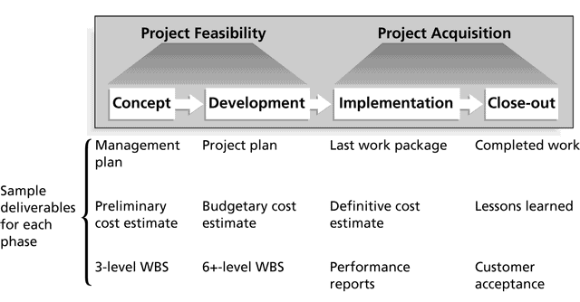
Figure 2-3. Phases of the Traditional Project Life Cycle

Slide 22
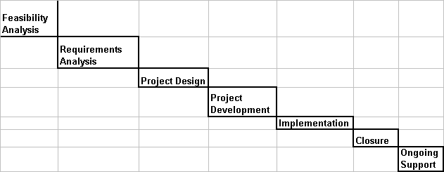
Waterfall Model

Slide 23
Product Life Cycles
Products also have life cycles.
A systems development life cycle (SDLC) is a framework for describing the phases involved in developing information systems.
Systems development projects can follow:
  Predictive life cycle: The scope of the project can be clearly articulated and the schedule and cost can be predicted.
  Adaptive Software Development (ASD) life cycle: Projects are mission driven and component based, and use time-based cycles to meet target dates.

Slide 24
Predictive Life Cycle Models
Waterfall model: Has well-defined, linear stages of systems development and support.
Spiral model: Shows that software is developed using an iterative or spiral approach rather than a linear approach.
Incremental build model: Provides for progressive development of operational software.
Prototyping model: Used for developing prototypes to clarify user requirements.
Rapid Application Development (RAD) model: Used to produce systems quickly without sacrificing quality.

Slide 25
Adaptive Life Cycle Models
Extreme programming (XP): Developers program in pairs and must write the tests for their own code. XP teams include developers, managers, and users.
Scrum: Iterative development in which repetitions are referred to as sprints, which normally last thirty days. Teams often meet each day for a short meeting, called a scrum, to decide what to accomplish that day. Works best for object-oriented technology projects and require strong leadership to coordinate the work.

Slide 26







Project Life Cycle
Design
Define Vendor Relationship
Develop Process Design
Develop Overall System Design
Develop Detailed System Specifications
Define System Security
Develop Test Plan
Develop Training Plan
Develop Test Scripts
Analysis
Define Project Deliverables
Define Ongoing Support Deliverables
Gather System Requirements
Define and Implement Change
Management Process
Feasibility
Build
Build Business Case
Determine Technical Feasibility
Validate Alignment with
Overall Business Objectives
Develop Application Standards
Construct Detailed System Specifications
Execute and Validate Test Results
Develop Operational Support
Develop Business Continuity Plan
Conduct Training
Complete System Acceptance
Implement System
Closure
Ongoing Use
Post-Implementation Change Control
Record Retention
Post-Implementation Periodic Reviews
Identify and Document Lessons Learned
Turnover Support Deliverables for Ongoing Support
Closure Celebration
Quality Checkpoint
& Go/No Go Decision

Slide 27
Feasibility Analysis
When someone proposes a potentially great idea, it is important to validate the request is in the best business interest.
A business case can:
  Clearly define the reason why the idea should be implemented.
  Help explain how the idea will impact the business.
  Ensure the project stakeholders fully understand the current business situation.
  Provide a basis for cost and benefit analysis.

Slide 28
Feasibility Analysis
Components of a Feasibility Analysis include:
  Problem Statement
  Project Objectives
  Project Scope
  Description of Current Situation or Environment
  Cost and Benefit Analysis

Slide 29
Requirements Analysis
There are four activities to consider for this phase:
  Define project deliverables
    These are specific business requirements.
  Define on-going support deliverables
    These set expectations for system support after delivery.
  Gather system requirements
    Brainstorm session to identify all technology needs.
  Define and implement a change management process
    Management of the previously defined project requirements.

Slide 30
Project Design
This is the blueprint phase of a project.
Deliverables for this phase include:
  Define the vendor relationship
  Develop the process and system design
  Develop the detailed system specifications
  Develop system security environment
  Create training plans
  Create test plans and scripts

Slide 31
Project Development
This is often considered the build phase.
Deliverables for this phase include:
  Develop application standards
  Construct detailed system specifications
  Execute and validate test results
  Perform training
  Create operational support materials
  Develop business continuity plans
  Complete system acceptance activities

Slide 32
Implementation and Closure
This is a relatively short phase in the project.
Deliverables for this phase include:
  Identification and documentation of lessons learned
  Turnover of on-going operational support documentation to the support team
  Celebration for a job well done by the project team

Slide 33
On-going Support
This phase can extend many times longer than the actual project work.
Deliverables for this phase include:
  Post-implementation change control management.
  Record retention for data archival.
  Post-implementation periodic reviews to provide a communication channel between the customers and support team.
    These reviews can identify new projects and application enhancements.

Slide 34
Quality Checkpoints
At a point between each project phase, there should be a quality checkpoint.
This provides an opportunity to:
  Evaluate the current situation
  Confirm business priorities have not changed
  Validate the project is on the right course
  Make adjustments to address project concerns

Slide 35
The Importance of Project Phases and Management Reviews
A project should successfully pass through each of the project phases in order to continue on to the next.
Management reviews, also called phase exits or kill points, should occur after each phase to evaluate the project’s progress, likely success, and continued compatibility with organizational goals.

Slide 36
What Went Right?
"The real improvement that I saw was in our ability to⎯in the words of Thomas Edison⎯know when to stop beating a dead horse…Edison's key to success was that he failed fairly often; but as he said, he could recognize a dead horse before it started to smell...In information technology we ride dead horses⎯failing projects⎯a long time before we give up. But what we are seeing now is that we are able to get off them; able to reduce cost overrun and time overrun. That's where the major impact came on the success rate.”*
Many organizations, like Huntington Bancshares, Inc., use an executive steering committee to help keep projects on track.
*Cabanis, Jeannette, “A Major Impact: The Standish Group's Jim Johnson On Project Management and IT Project Success,” PM Network, PMI (September 1998), p. 7.

Slide 37
The Context of IT Projects
IT projects can be very diverse in terms of size, complexity, products produced, application area, and resource requirements.
IT project team members often have diverse backgrounds and skill sets.
IT projects use diverse technologies that change rapidly. Even within one technology area, people must be highly specialized.

Slide 38
Chapter Summary
Project managers need to take a systems approach when working on projects.
Organizations have four different frames: structural, human resources, political, and symbolic.
The structure and culture of an organization have strong implications for project managers.
Projects should successfully pass through each phase of the project life cycle.
Project managers need to consider several factors due to the unique context of information technology projects.

